Slide 1
Revision (OOP)
WXES1117 : Data Structure

Slide 2
Check point 1
Name an object.
What can the object do?
Name a different object.
Does this 2nd object have the same function(s) as the initially named object?

Slide 3
Class & Object
Object : represents an entity in the real world.
(i.e. : car, apple, ball, chair, computer)
Object has : - unique identity,
- state (variables/data fields)
- behaviors (methods)
Class : constructs that define objects of the same type.

Slide 4
Objects
An object has both a state and behavior. The state defines the object, and the behavior defines what the object does.

Slide 5
UML Class Diagram
Q: Declare the class, properties and methods for the UML
diagram above.

Slide 6
Classes

Slide 7
Constructors
Constructors are a special kind of methods that are invoked to construct objects.
Circle() {
}
Circle(double newRadius) {
radius = newRadius;
}

Slide 8
Constructors, cont.
A constructor with no parameters is referred to as a no-arg constructor.
· Constructors must have the same name as the class itself.
· Constructors do not have a return type—not even void.
· Constructors are invoked using the new operator when an object is created. Constructors play the role of initializing objects.

Slide 9
Check point 2
What is the difference between constructors and methods?
Can a class have more than one constructors?
What are constructors used for? and how?
What operator is used to invoke a constructor?
When will a class have a default constructor?

Slide 10
Differences between Variables of Primitive Data Types and Object Types

Slide 11
Copying Variables of Primitive Data Types and Object Types

Slide 12
Visibility Modifiers and Accessor/Mutator Methods
By default, the class, variable, or method can be accessed by any class in the same package.
public
The class, data, or method is visible to any class in any package.
private
The data or methods can be accessed only by the declaring class.
The get and set methods are used to read and modify private properties.

Slide 13
The private modifier restricts access to within a class, the default modifier restricts access to within a package, and the public modifier enables unrestricted access.

Slide 14
Why Data Fields Should Be private?
Encapsulation
Information hiding
To protect data.
To make class easy to maintain.

Slide 15
Example of Data Field Encapsulation
CircleWithPrivateDataFields
TestCircleWithPrivateDataFields

Slide 16
Inheritance
Circles, rectangles, triangles..do they share common features?
Suppose you will define classes to model circles, rectangles, and triangles. These classes have many common features. What is the best way to design these classes so to avoid redundancy?
The answer is to use inheritance.

Slide 17
Superclasses and Subclasses
Q:
Is subclass a subset of superclass?
Private accessible outside class?
Extensible?
Multiple inheritance?
Superclass constructor inherited?

Slide 18
Calling superclass constructor
Syntax :
super() or super(parameters)
public Circle (
double radius, String color, boolean filled) {
super(color, filled);
this.radius = radius;
}

Slide 19
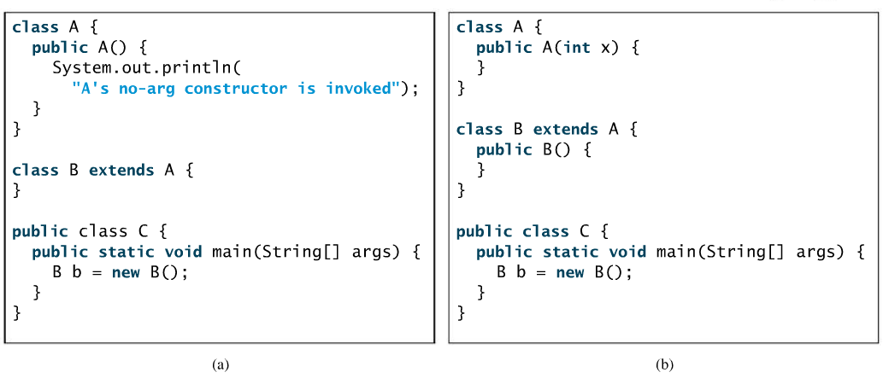
What’s the printout of running class C? In both (a) and (b).
(a) A’s no-arg constructor is invoked (b) error – no A() constructor

Slide 20
Overriding vs. Overloading
Overloading : define multiple methods , same name but different parameter list; can be in same or different class
Overriding : provide new implementation for a method in the subclass; different classes related by inheritance; same parameter list and return type

Slide 21
Overriding vs. Overloading
(a) (b)
Output (a) : 10 Output (b) : a.p(10) – p(int i) - 10
a.p(10) & a.p(10.0) both a.p(10.0) – p(double i) – 20.0
invoke p(double i) defined in class A

Slide 22
Polymorphism
A variable of a supertype can refer to a subtype object.
e.g 1 :
GeometricObject geoObj = new Circle();
e.g 2 :
Fruit f = new Apple();

Slide 23
Generic Programming
public class PolymorphismDemo {
public static void main(String[] args) {
m(new GraduateStudent());
m(new Student());
m(new Person());
m(new Object());
}
public static void m(Object x) {
System.out.println(x.toString());
}
}
class GraduateStudent extends Student {
}
class Student extends Person {
public String toString() {
return "Student";
}
}
class Person extends Object {
public String toString() {
return "Person";
}
}
Polymorphism allows methods to be used generically for a wide range of object arguments. This is known as generic programming. If a method’s parameter type is a superclass (e.g., Object), you may pass an object to this method of any of the parameter’s subclasses (e.g., Student or String). When an object (e.g., a Student object or a String object) is used in the method, the particular implementation of the method of the object that is invoked (e.g., toString) is determined dynamically.
Output :
Student
Student
Person
Java.lang.Object@39274

Slide 24
Accessibility Summary

Slide 25
Visibility Modifiers

Slide 26
Abstract Classes and Abstract Methods
GeometricObject
Circle
Rectangle
TestGeometricObject
26

Slide 27
1. abstract method in abstract class
An abstract method cannot be contained in a nonabstract class.
public class GeometricObject {
public abstract double getArea();
}
27

Slide 28
2. object cannot be created from abstract class
An abstract class cannot be instantiated using the new operator
GeometricObject geoObj = new GeometricObject();
but you can still define its constructors, which are invoked in the constructors of its subclasses. For instance, the constructors of GeometricObject are invoked in the Circle class and the Rectangle class.
28

Slide 29
3. abstract class without abstract method
A class that contains abstract methods must be abstract.
public abstract class GeometricObject {
public abstract double getArea();
}
29

Slide 30
4. superclass of abstract class may be concrete
A subclass can be abstract even if its superclass is concrete. For example, the Object class is concrete, but its subclasses, such as GeometricObject, may be abstract.
public class Object {}
public abstract class GeometricObject {}
30

Slide 31
5. concrete method overridden to be abstract
A subclass can override a method from its superclass to define it abstract. This is rare, but useful when the implementation of the method in the superclass becomes invalid in the subclass. In this case, the subclass must be defined abstract.
31

Slide 32
public abstract class GeometricObject{
public String someMethod();
}
public abstract class Circle extends GeometricObject {
public abstract String someMethod();
}

Slide 33
6. abstract class as type
You cannot create an instance/object from an abstract class using the new operator, but an abstract class can be used as a data type. Therefore, the following statement, which creates an array whose elements are of GeometricObject type, is correct.
GeometricObject[] geo = new GeometricObject[10];
geo[0] = new Circle();
geo[1] = new Rectangle();
33

Slide 34
What is an interface? Why is an interface useful?
A classlike construct that contains only constants and abstract methods.
Similar to an abstract class, but the intent of an interface is to specify common behavior for objects. For example, you can specify that the objects are comparable, edible, cloneable using appropriate interfaces.
Cannot create an instance using the new operator
34

Slide 35
Define an Interface
To distinguish an interface from a class, Java uses the following syntax to define an interface:
public interface InterfaceName {
constant declarations;
method signatures;
}
Example:
public interface Edible {
/** Describe how to eat */
public abstract String howToEat();
}
35

Slide 36
Extend vs Implement
A Java class may implement an interface.
An interface may extend, any number of interfaces; however an interface may not implement an interface.
A class that implements an interface must implement all of the methods described in the interface, or be an abstract class.

Slide 37
Example
You can now use the Edible interface to specify whether an object is edible. This is accomplished by letting the class for the object implement this interface using the implements keyword. For example, the classes Chicken and Fruit implement the Edible interface (See TestEdible).
Edible
TestEdible
Run
37

Slide 38
Check point 2
How to do you create an interface called Walking having a howToWalk()?
If A is an abstract class. Can you create an instance using new A() ?
If A is an abstract class. Can you declare a reference variable x with type A like this?
A x;

Slide 39
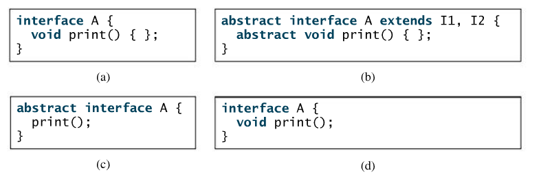
Which is a correct interface?
Correct answer : (d)

Slide 40
Interfaces vs. Abstract Classes
In an interface, the data must be constants; an abstract class can have all types of data.
Each method in an interface has only a signature without implementation; an abstract class can have concrete methods.
 | Variables | Constructors | Methods
Abstract class | No restrictions | Constructors are invoked by subclasses through constructor chaining. An abstract class cannot be instantiated using the new operator. | No restrictions.
Interface | All variables must be public static final | No constructors. An interface cannot be instantiated using the new operator. | All methods must be public abstract instance methods
40

Slide 41
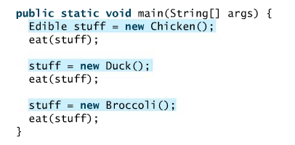
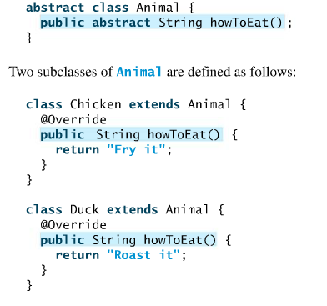
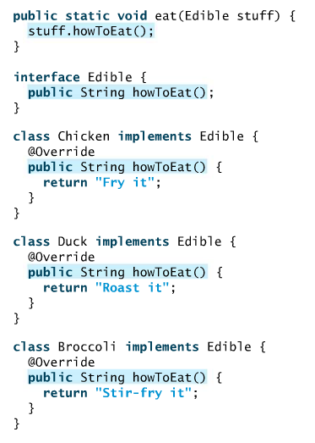
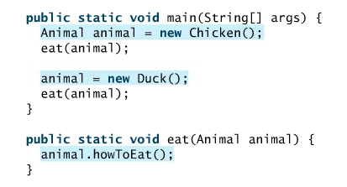
Abstract class
Interface

Slide 42
Java allows single inheritance, but multiple extensions
public class NewClass extends BaseClass implements Interface1, ...., InterfaceN {
}

Slide 43
An interface can inherit other interfaces using extends keyword. The extended interface is called subinterface.
public interface NewInterface extends Interface1, ...., InterfaceN {
//constants and abstract methods
}

